Slide 1
Mining Git
How to automate my activities in git

Slide 2
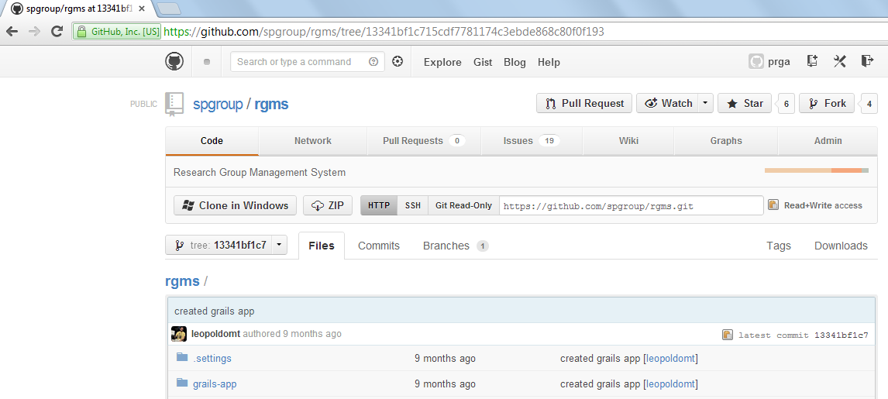
Download Zipped Commits from GitHub

Slide 3



1st step: download and unzip commits
GIT
Base
Feature A
…
Feature B

Slide 4
2nd step: compute features changesets from base commit
________
Feature A
Changeset A
________
Base
Feature B
Changeset B
…
________
Feature N
Changeset N

Slide 5
3rd step: compute features changesets intersection
For features A, B and C:
________
________
=
________
U
Changeset A
Changeset B
A ^ B
________
U
________
=
________
Changeset A
Changeset C
A ^ C
________
U
________
=
________
Changeset B
Changeset C
B ^ C

Slide 6
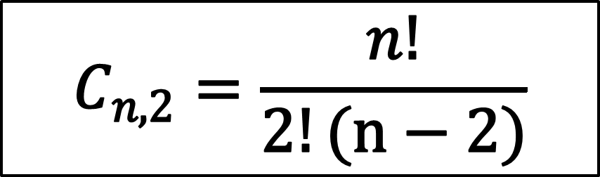
Formula for calculating the intersection for n features
$$C_{n,2}=\frac{n!}{2!(n−2)}$$

Slide 7

At the end we’ll have all a list of files that were changed in parallel by developers implementing different feature, that is, potential conflicts
F1
F2
System

Slide 8

Step-by-step
Download zipped commit
Unzip commit
Compute differences between code assets
Calculate changesets from the base commit
Calculate changesets intersections between commits
Show reports

Slide 9
Future work
Parse the intersection files to check whether the changes made in parallel were confined to the same methods

